Slide 1
UCSD Embedded C Assignment 9
By
Hsuankai Chang
hsuankac@umich.edu

Slide 2
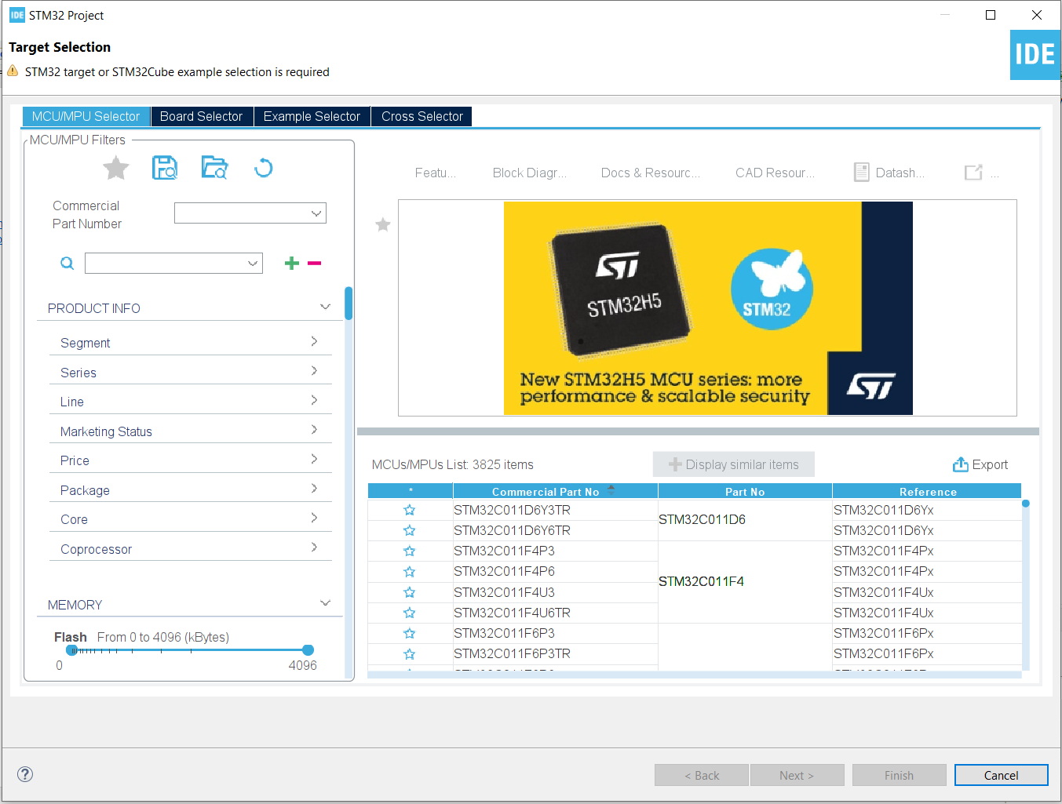
Step 1. Startup STM32CubeIDE and create new STM32 project

Slide 3
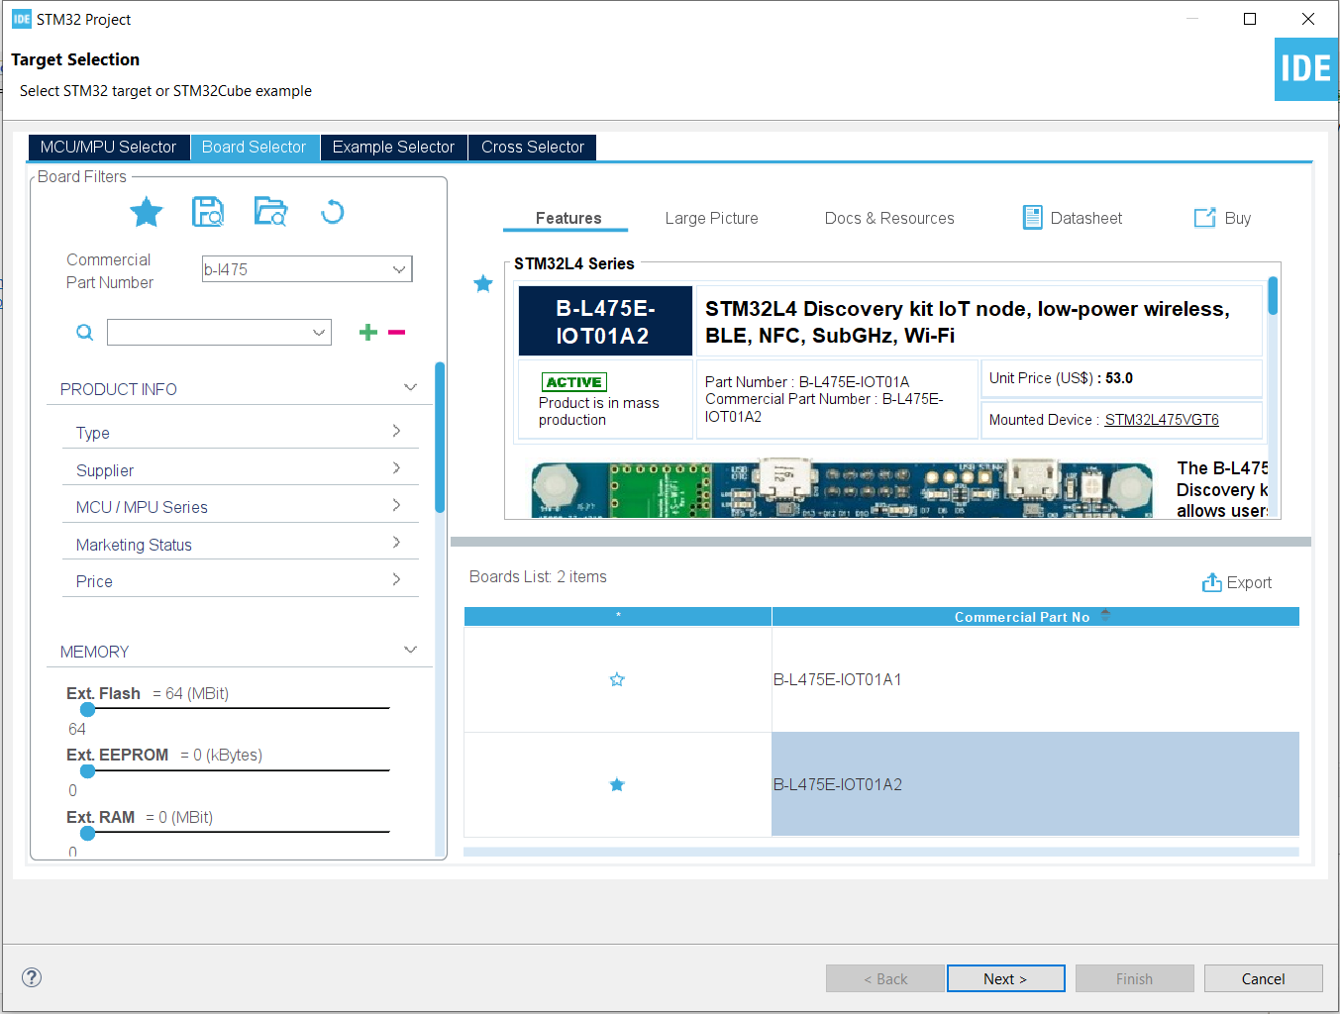
Step 2. Access board selector and type in the board you use, click Next

Slide 4
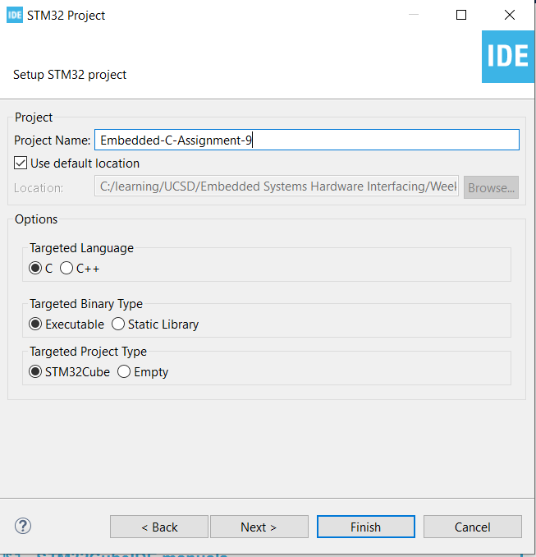
Step 3. Enter the project name then click Next

Slide 5
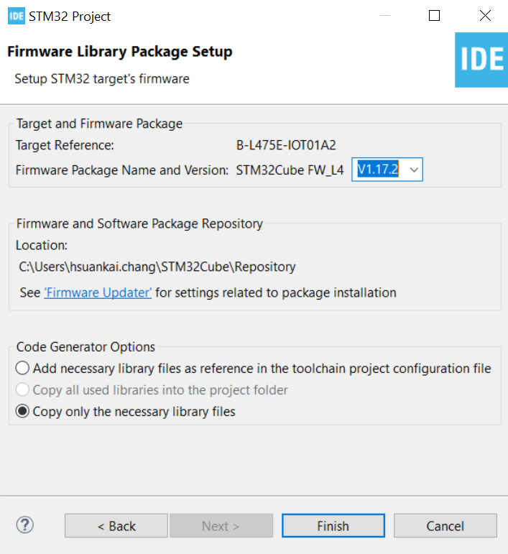
Step 4. See the firmware package name, version and location

Slide 6
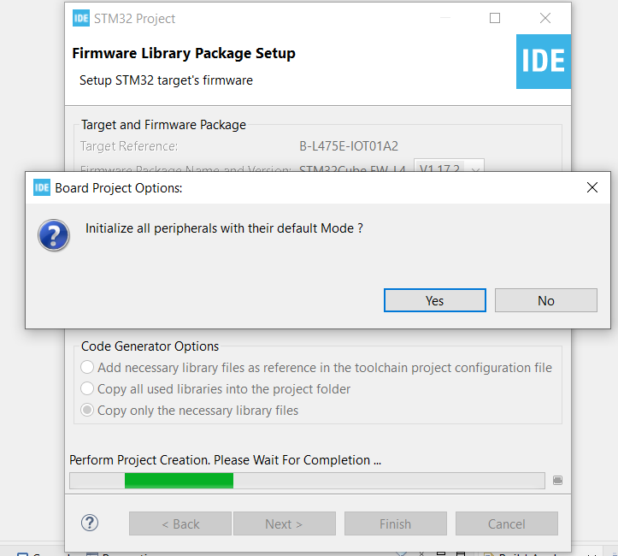
Step 5. Click yes to initialize all peripherals to default

Slide 7
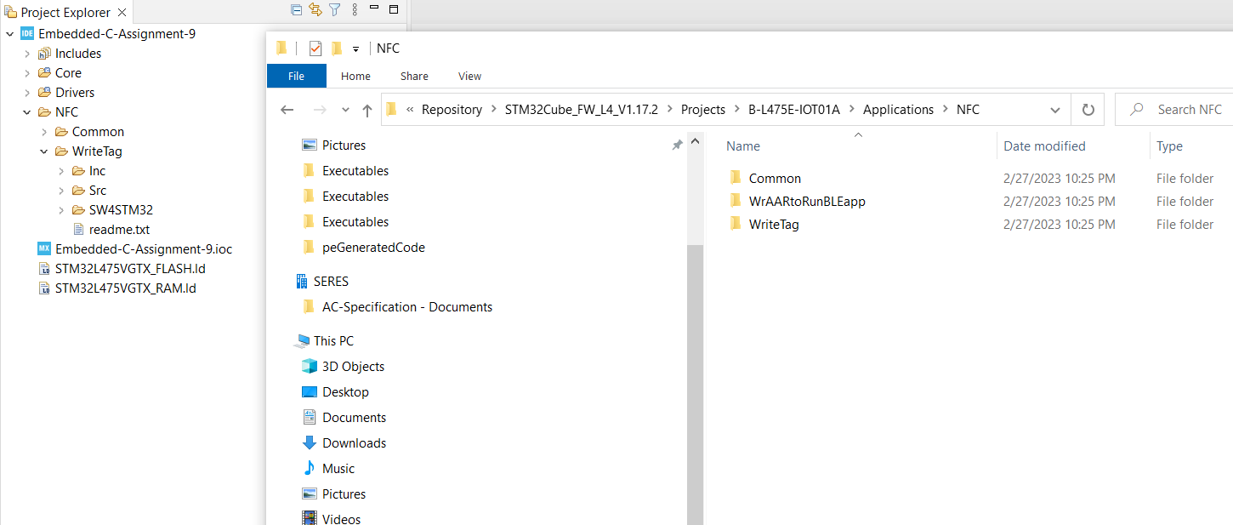
Step 6. Copy the NFC folder into the project, and delete the WrAARtoRunBLEapp folder

Slide 8
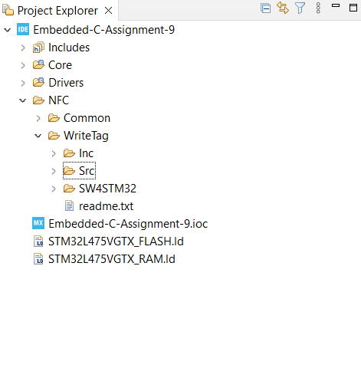
Step 7. Delete EWARM and MDK-ARM folder

Slide 9
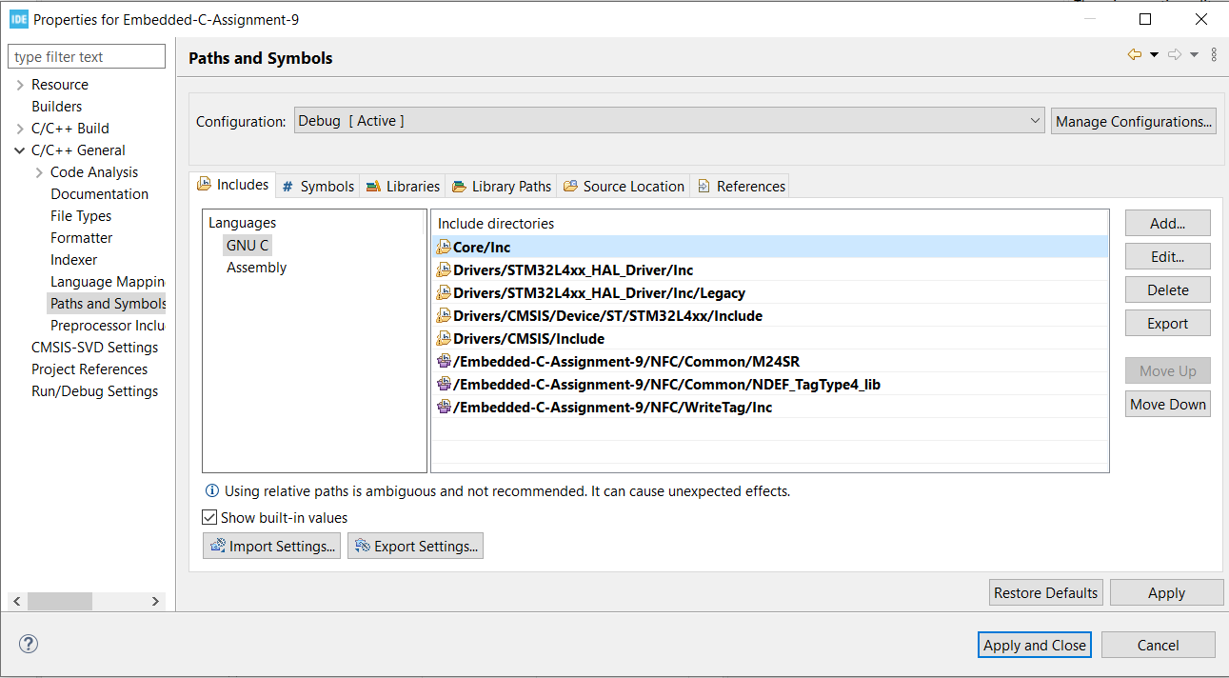
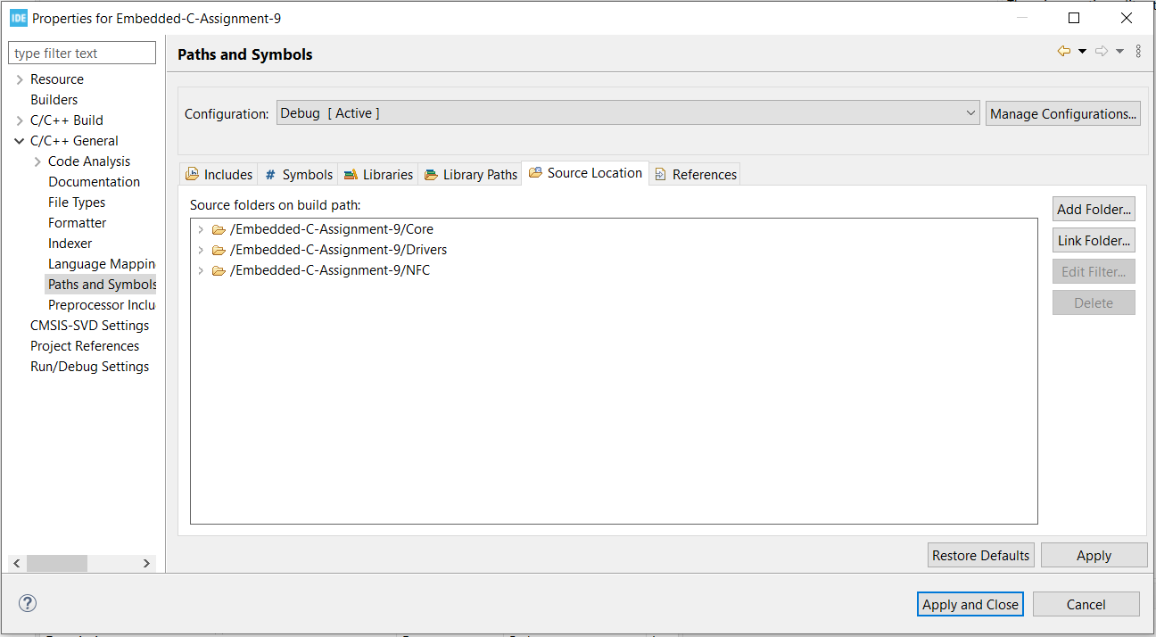
Step 8. Add the NFC source path and include path

Slide 10
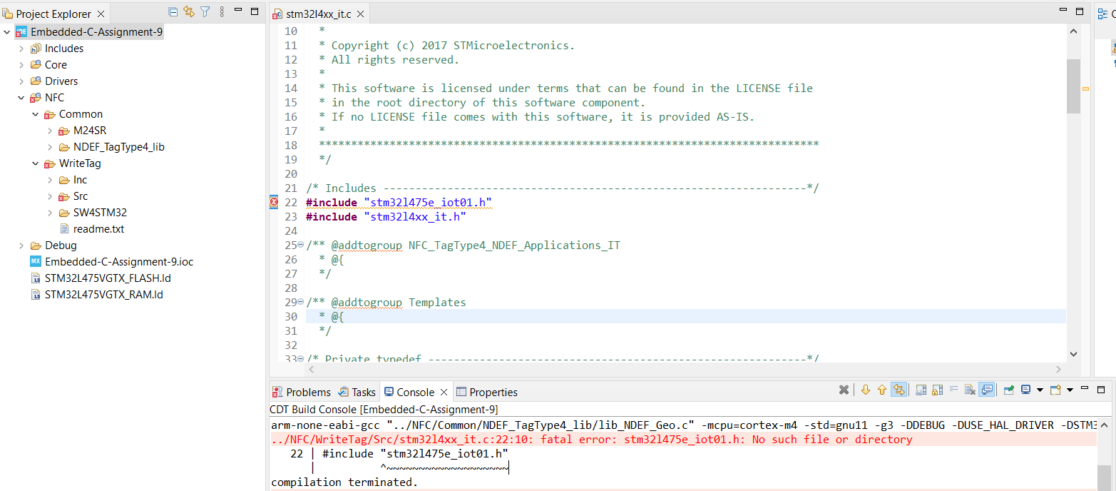
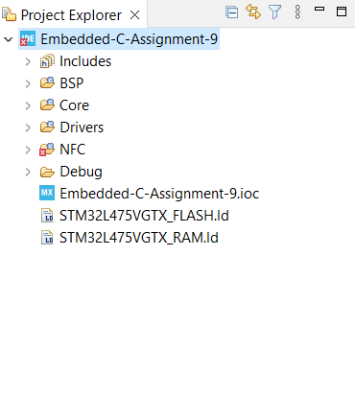
Step 9. When attempting to build, missing file is in BSP, so add BSP folder in the project

Slide 11
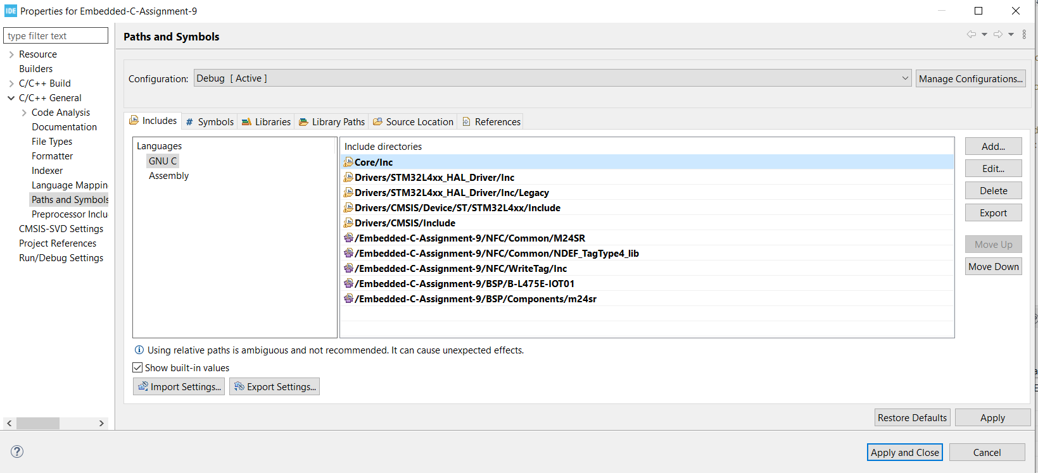
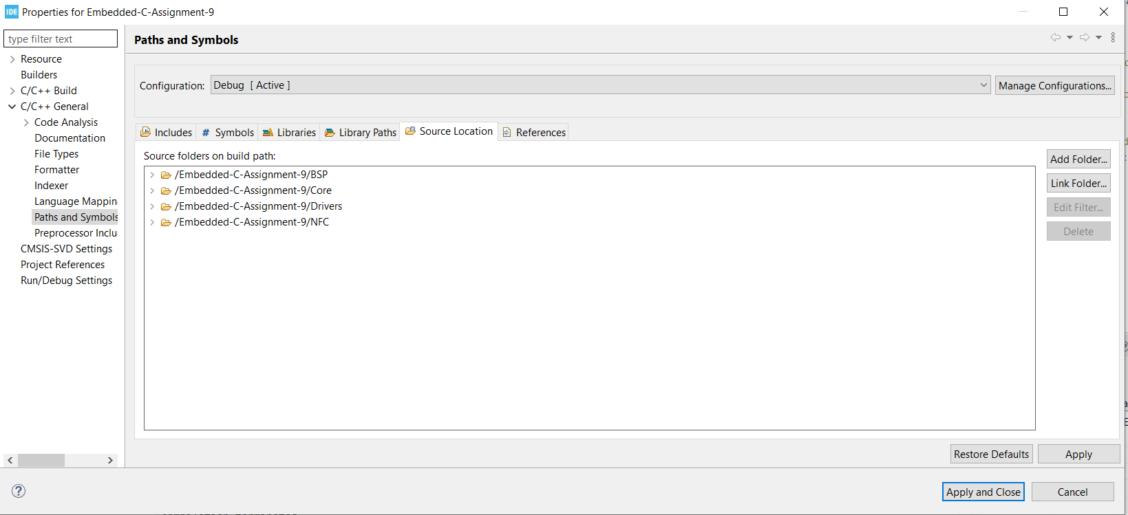
Step 10. Add the BSP m24sr into include path, and add BSP into source path

Slide 12
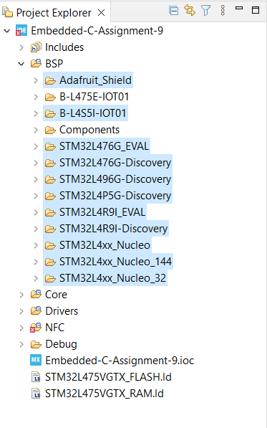
Step 11. Delete unnecessary folder under BSP folder

Slide 13
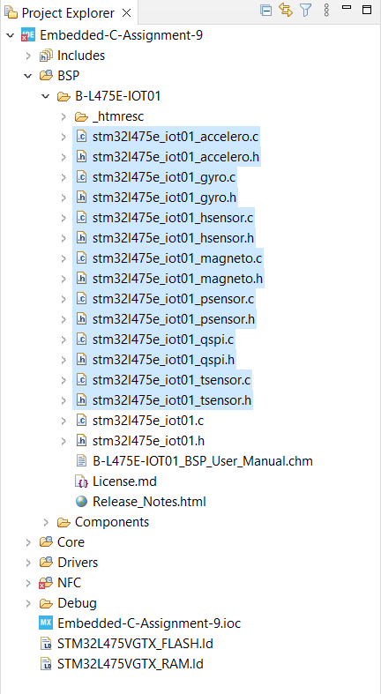
Step 12. Delete unnecessary files under B-L475E-IOT01 folder

Slide 14
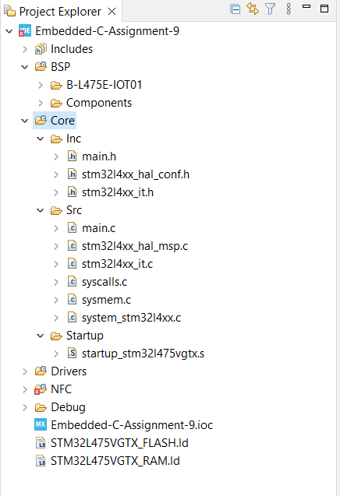
Step 13. Remove the entire Core directory

Slide 15
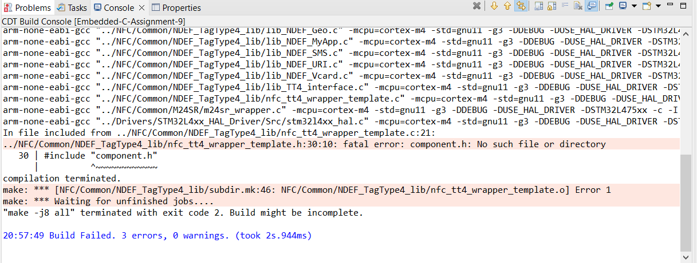
Step 14. Missing component.h file

Slide 16
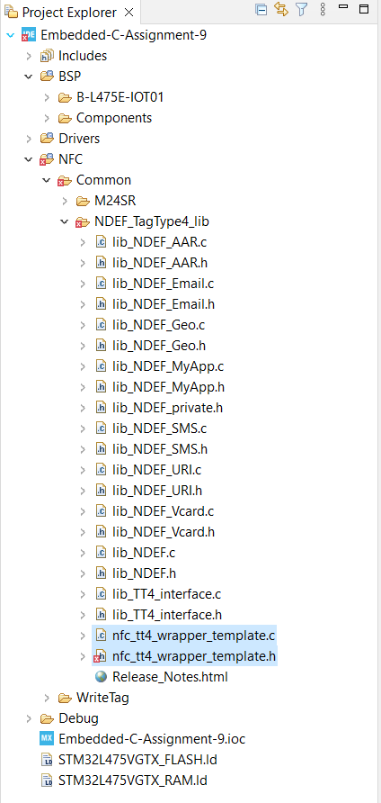
Step 15. Remove nfc_tt4_wrapper_template.c and .h files

Slide 17
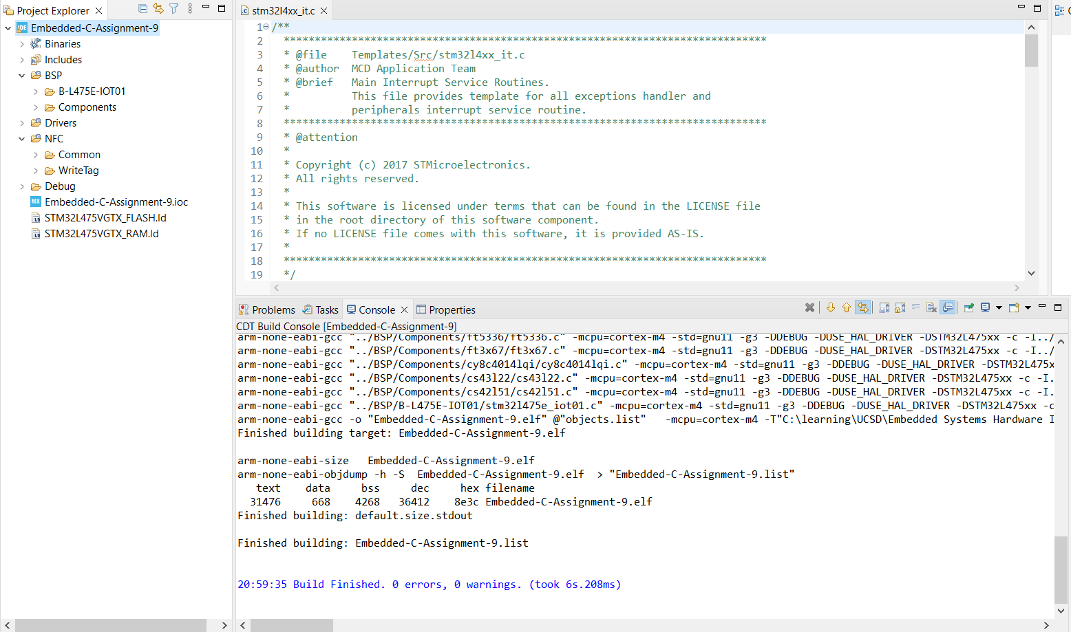
Step 16. Finally, we get a successful build

Slide 18
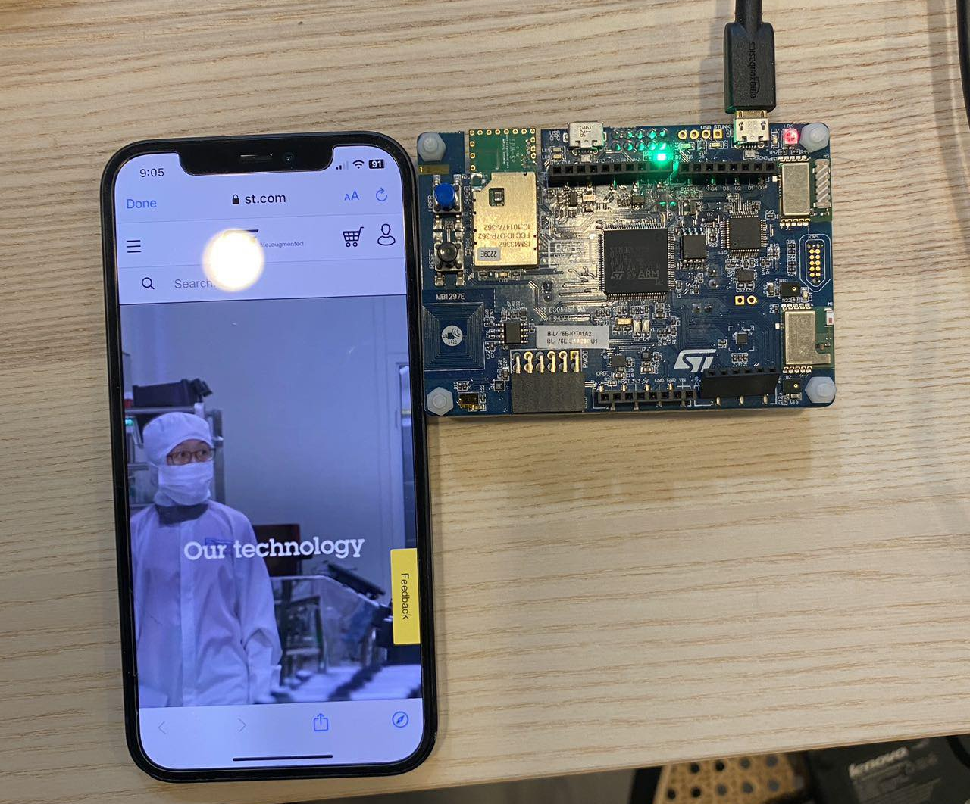
Step 17. Run the code and open iphone with GoToTags app, we can see the tags pops up and LED rate changing

Slide 19
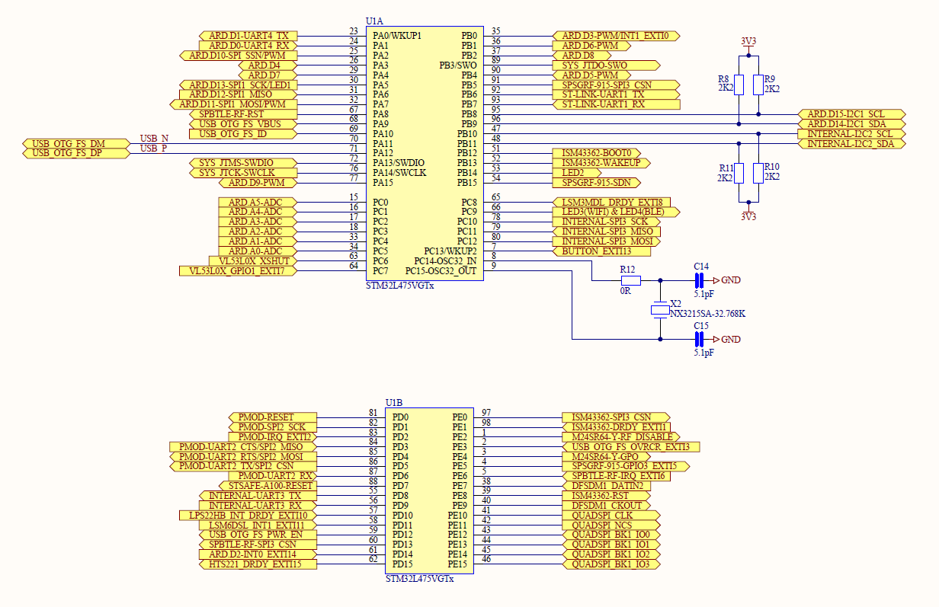
Appendix, schematic for NFC module, processor side connection

Slide 20
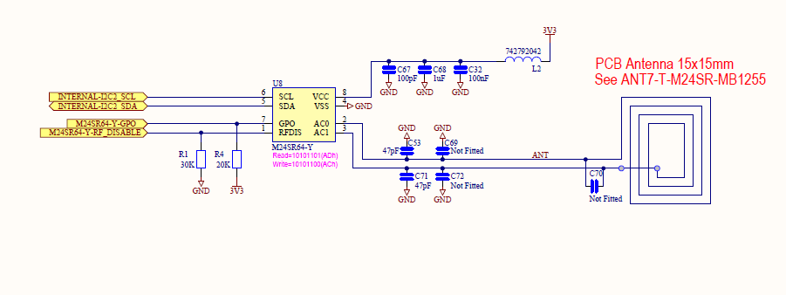
Appendix, schematic for NFC module

